Slide 1
NLP in Software Engineering

Slide 2
What are the various industry application of NLP that come to your mind?
Search engines
Advanced text editors: Such as Grammarly.com
Computational advertising
Fraud detection
Sentiment analysis
Opinion mining
Text summarization
Context analysis

Slide 3
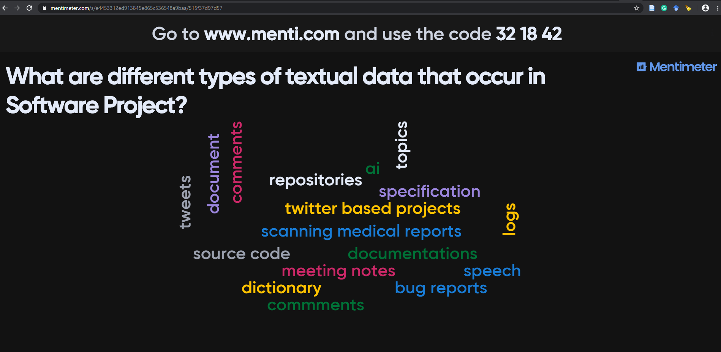
Software projects are textual in nature.
Menti meter to add some words to this wordle

Slide 4
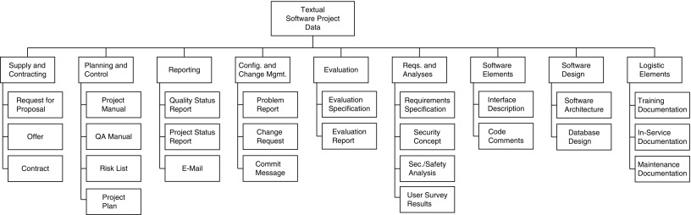

Textual data in Software Project
Semi structured
Source of Data: specifications,
design and architecture documents,
test cases, test results, review results.
Also: Team members now a days communicate via e-mails and chats, change requests, and commit messages, which all are available electronically as text sources.
Finally, in a software project, especially in the context of product development, customer surveys and product reviews
Un structured
Bird, Christian, Tim Menzies, and Thomas Zimmermann, eds. The art and science of analyzing software data. Elsevier, 2015.

Slide 5


Source: Journal Gazett https://www.google.com/url?sa=i&url=https%3A%2F%2Fjournalgazette.net%2Fnews%2Flocal%2F20190614%2Fphotos-of-the-week&psig=AOvVaw1vy1qZ58aHaQ-P62fIIuU5&ust=1581277010885000&source=images&cd=vfe&ved=0CAMQjB1qFwoTCKjesofawucCFQAAAAAdAAAAABAD

Slide 6
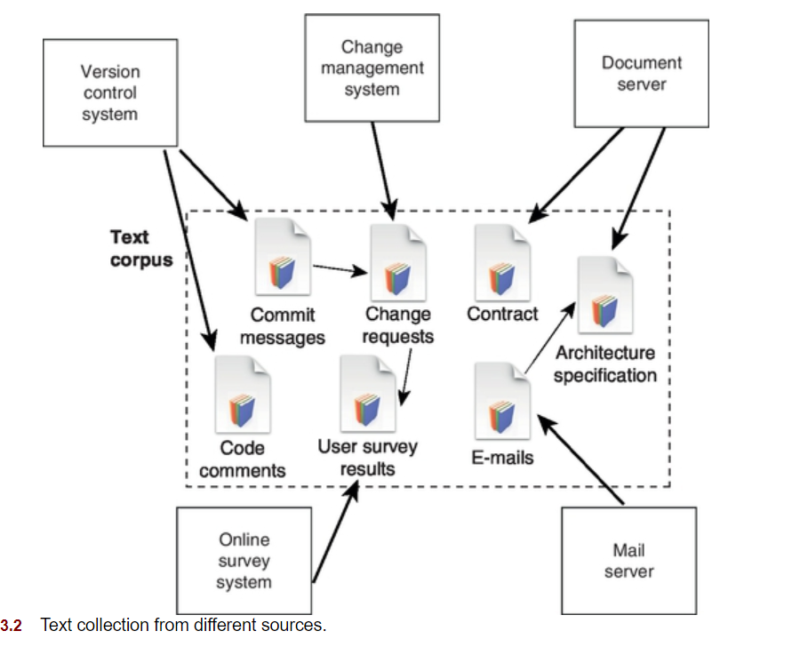





Textual Software Project Data and Retrieval [1]
Custom extraction tool
API’s
Formatted files
Anonymize
Web crawling
Arnaoudova, Venera, et al. "The use of text retrieval and natural language processing in software engineering." Proceedings of the 37th International Conference on Software Engineering-Volume 2. 2015.

Slide 7
Importance of NLP in Software Engineering
Text Retrieval (TR) and NLP in software is one of the fastest growing areas of research in SE. [2]
Exposing the SE community to these techniques and their applications in SE would help to fill a gap in their current background and allow them to immediately use TR and NLP to advance their research.
In particular, for TR, approaches such as Vector Space Model, Latent Semantic Analysis, Latent Dirichlet Association, Language Models will be covered. NLP techniques covered will include part-of-speech tagging, stemming, stopword elimination, semantics analysis, sentiment analysis, etc.

Slide 8
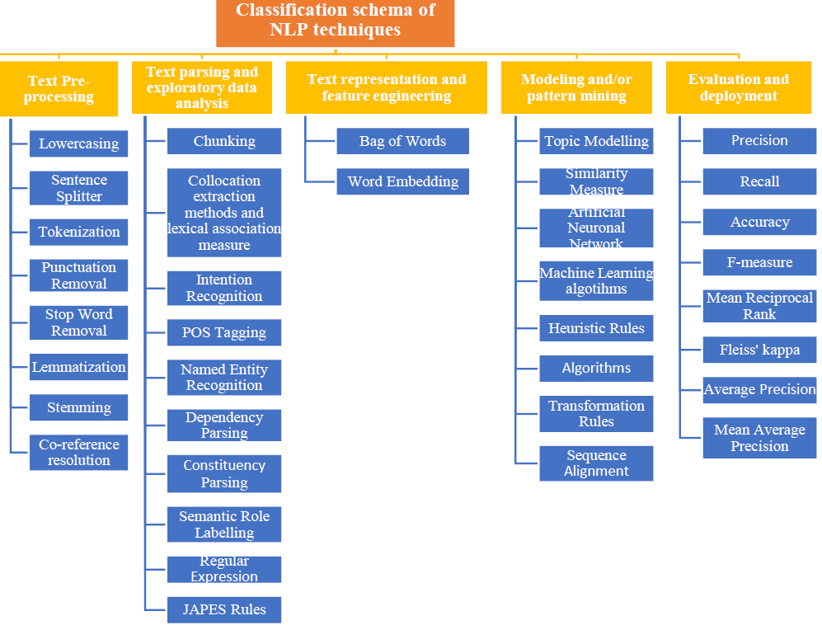
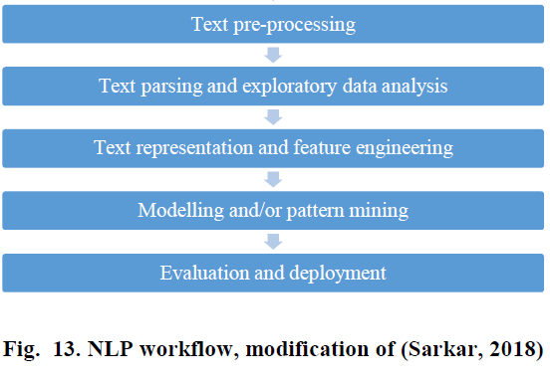
Moises Gonzalez-Garcia, Speech recognition, NLP, and the use of ontologies to identify the problem-domain and solution requirements: A systematic mapping study, Information and Software Technology, 2019, In press

Slide 9
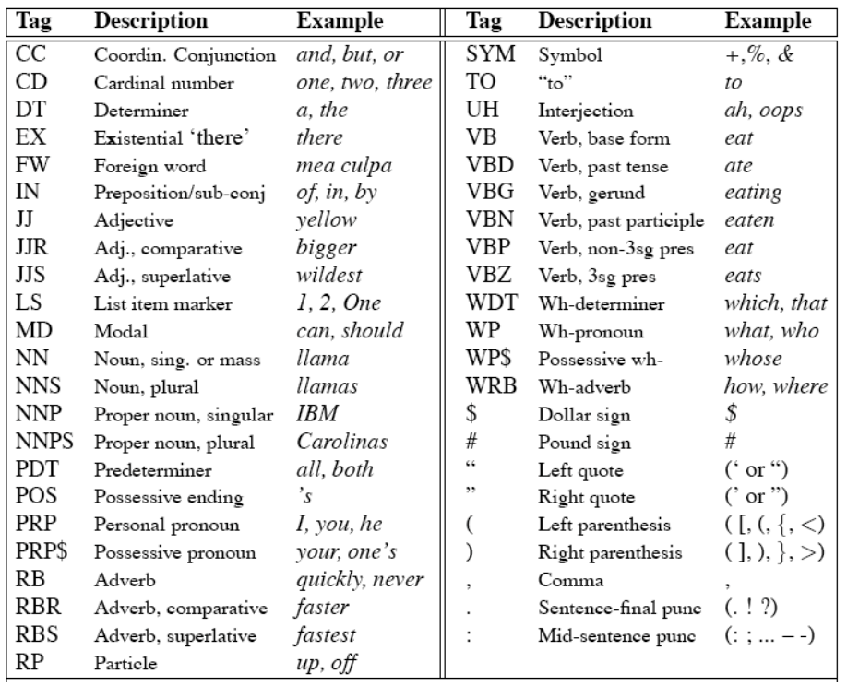
Part-of-Speech Tagging
The choice Tag Sets depends on the language and application
Example tag set sizes (for English)
– Brown corpus, 87 tags
– Penn treebank 45 tags
– BNC, 61 tags
Source : Penn Tree Bank Tagset - http://coltekin.net/cagri/courses/snlp2017/slides/pos-tagging.pdf

Slide 10
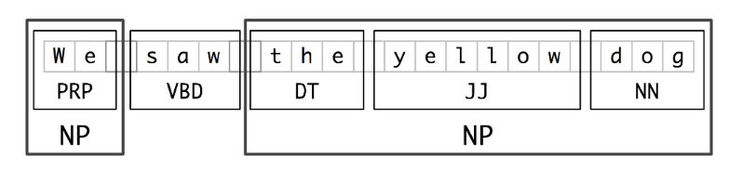
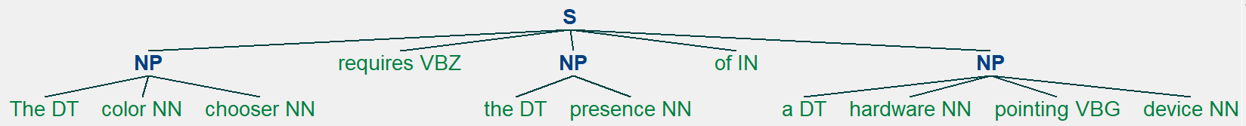
Chunking
The color chooser requires the presence of a hardware pointing device
POS Tagging (averaged_perceptron_tagger)
1
[('The', 'DT'), ('color', 'NN’),
('chooser', 'NN'), ('requires', 'VBZ’),
('the', 'DT’),('presence', 'NN'), ('of', 'IN'), ('a', 'DT'), ('hardware', 'NN’),
('pointing', 'VBG'), ('device', 'NN')]
grammar = r"""NP:{<DT>?<NN><VBG><NN>}
{<DT>?<NN>*}
{<NNP>*} """
2
3

Slide 11
Named Entity Recognition
Wikipedia: Named-entity recognition (NER) (also known as entity identification, entity chunking and entity extraction) is a subtask of information extraction that seeks to locate and classify named entity mentioned in unstructured text into pre-defined categories such as person names, organizations, locations, medical codes, time expressions, quantities, monetary values, percentages, etc.
Input: “When Michael Jordan was at the peak of his powers as an NBA superstar, his Chicago Bulls team were moving down the completion, winning six National Basketball Association titles”.
Output:
“Chicago Bulls”
“Michael Jordan”
“National Basketball Association”

Slide 12
N-gram
Computational linguists are looking for ways to predict what a next word in a sentence could be. One way to achieve this is by looking at the immediately preceding words.
The n-gram-based analysis of texts does not aim at abstracting the content of the texts but aims at categorizing or predicting attributes of them
Applications:
Google Ngram Viewer :compares how frequently words occur together in different texts or over time.
categorizing texts into their languages. On the basis of already learned models for different languages, n-grams can indicate in which language a given text is
automatically classify specification chapters into technical content and domain content. (Java Text Categorizing Library)
They built n-gram models for source code and then predicted how to complete code snippets similar to autocompletion in modern integrated development environments.

Slide 13
Moises Gonzalez-Garcia, Speech recognition, NLP, and the use of ontologies to identify the problem-domain and solution requirements: A systematic mapping study, Information and Software Technology, 2019, In press

Slide 14
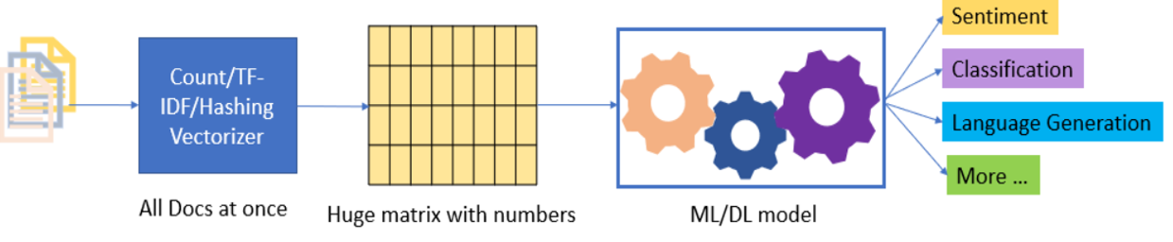
NLP and Machine learning
Source: https://www.datajango.com/deep-learning-and-nlp/

Slide 15
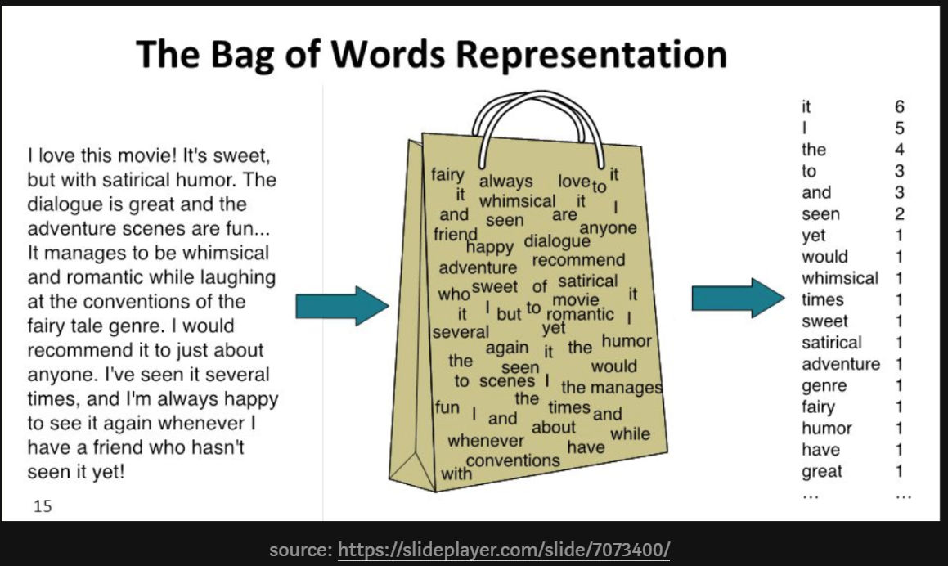
Bag of words
Methods that are used for natural language processing to represent
documents where the order of words (grammar) is not important.

Slide 16
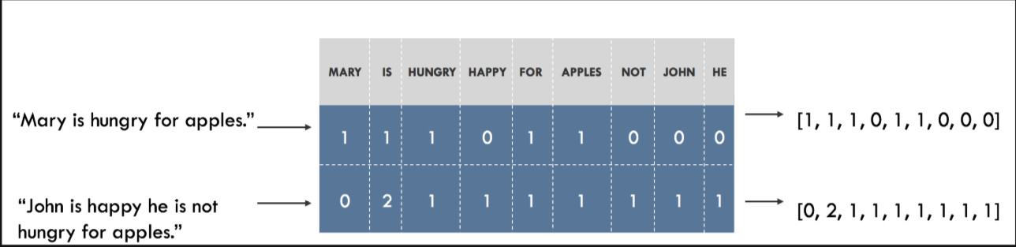
Source: https://blog.insightdatascience.com/how-to-solve-90-of-nlp-problems-a-step-by-step-guide-fda605278e4e

Slide 17
References
Bird, Christian, Tim Menzies, and Thomas Zimmermann, eds. The art and science of analyzing software data. Elsevier, 2015.
Arnaoudova, Venera, et al. "The use of text retrieval and natural language processing in software engineering." Proceedings of the 37th International Conference on Software Engineering-Volume 2. 2015.
Juergens, Elmar, et al. "Do code clones matter?." 2009 IEEE 31st International Conference on Software Engineering. IEEE, 2009.
Juergens, Elmar, et al. "Can clone detection support quality assessments of requirements specifications?." Proceedings of the 32nd ACM/IEEE International Conference on Software Engineering-Volume 2. ACM, 2010.
https://medium.com/square-corner-blog/topic-modeling-optimizing-for-human-interpretability-48a81f6ce0ed
Stevens, Keith, Kegelmeyer, Philip, Andrzejewski, David, and Buttler, David. Exploring topic coherence over many models and many topics. In EMNLP, 2012.

